Slide 1
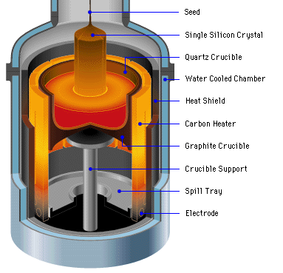
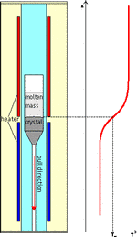
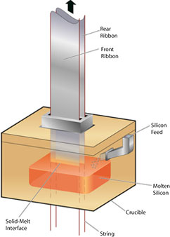

Slide 3
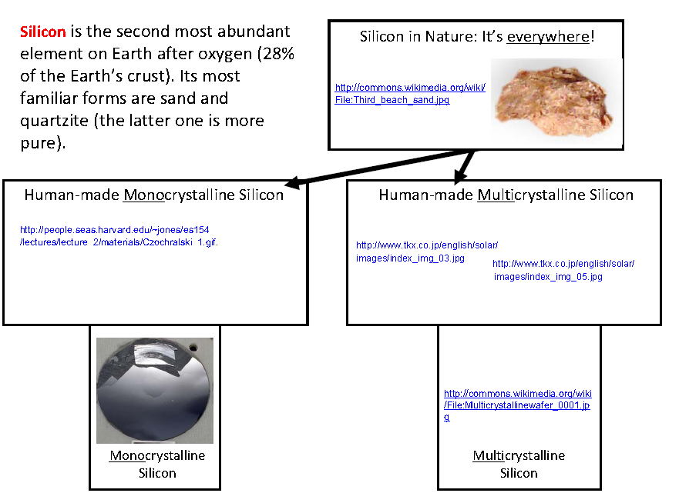
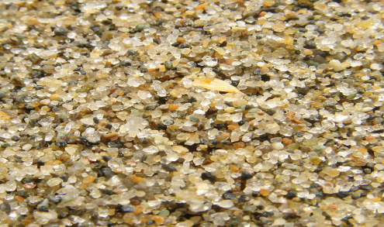
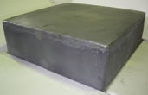
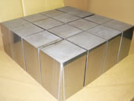
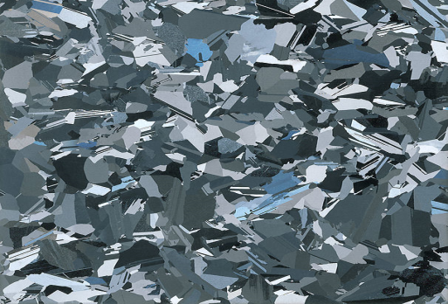

Slide 4
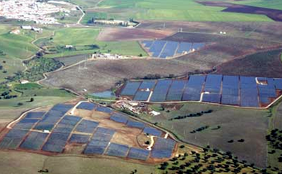
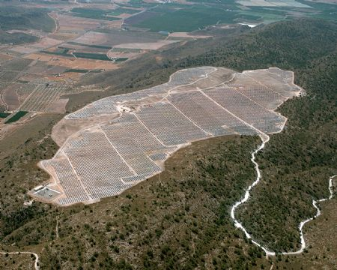
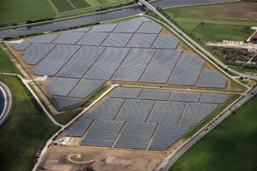

Slide 5
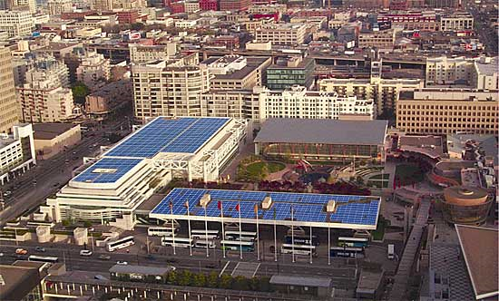
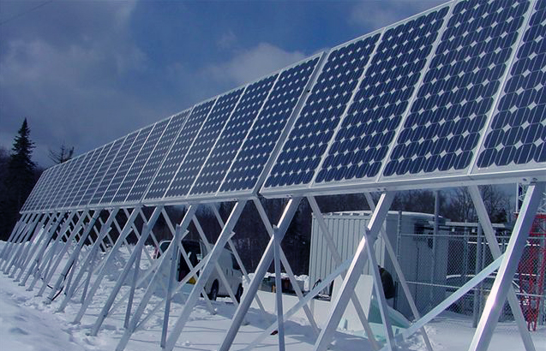

Slide 7
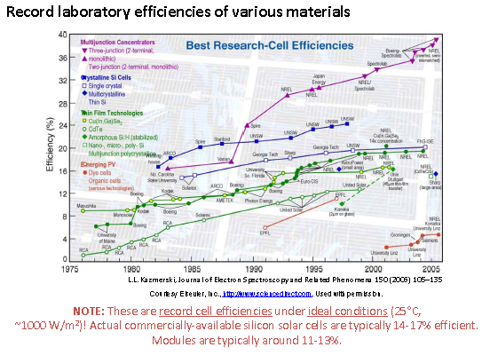

Slide 8
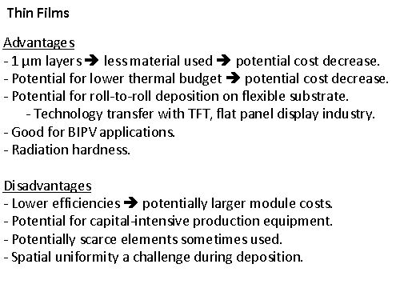
TFT – Thin Film Transsistor
BIPV – Built In PV

Slide 9
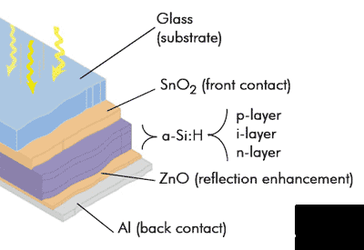

Slide 10
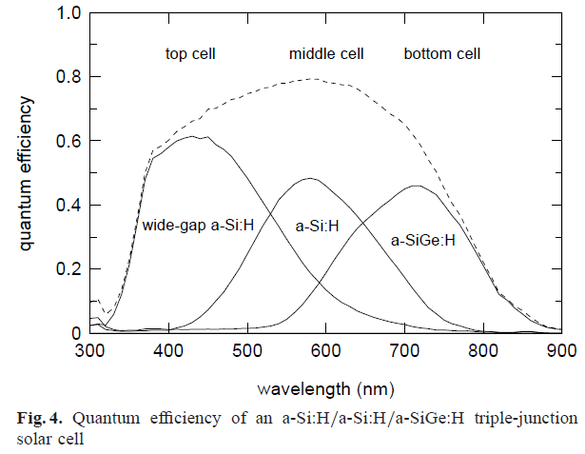

Slide 11
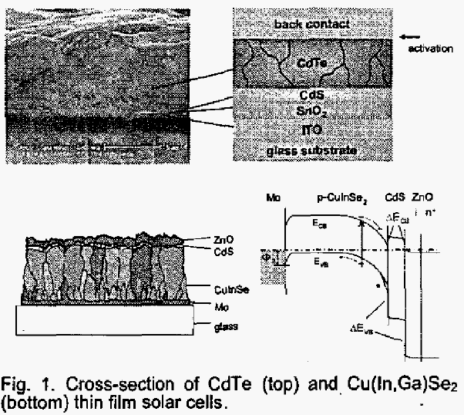

Slide 12
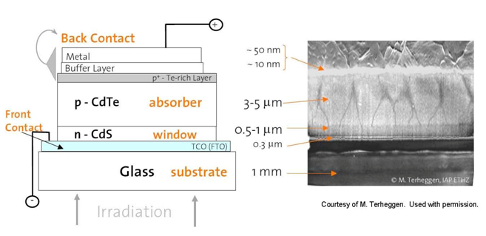

Slide 13
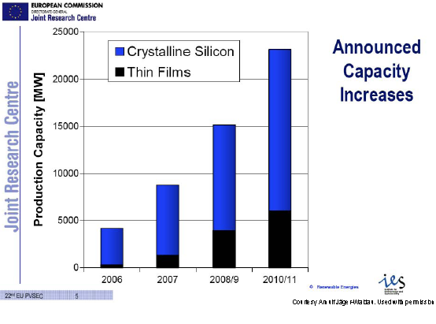

Slide 14
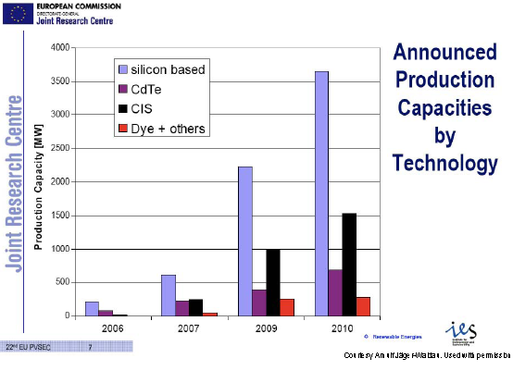

Slide 15
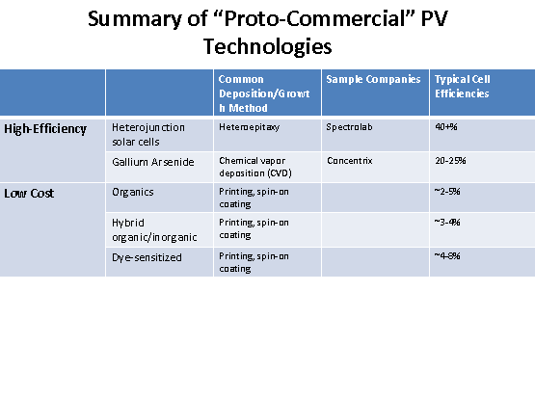

Slide 16
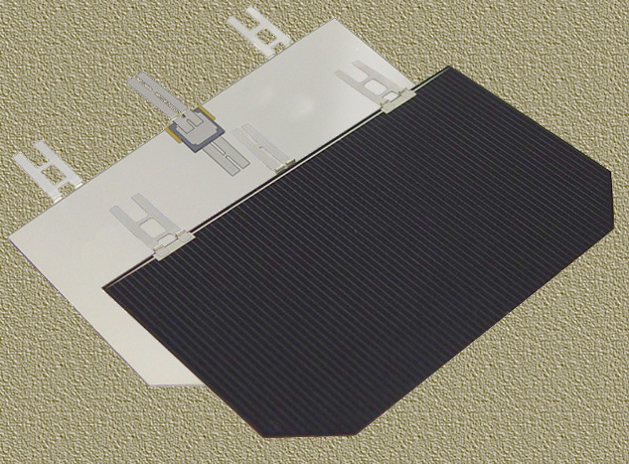

Slide 17
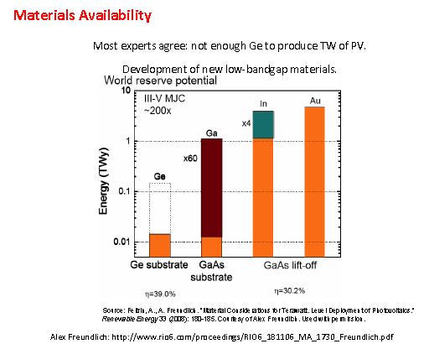

Slide 18
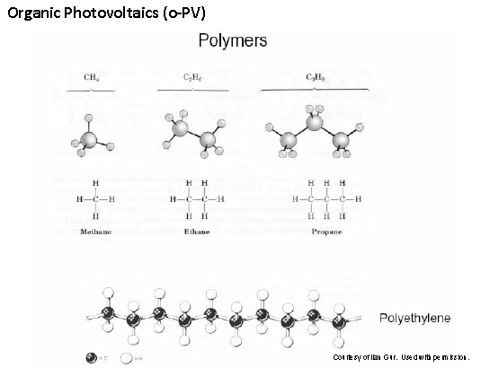

Slide 21
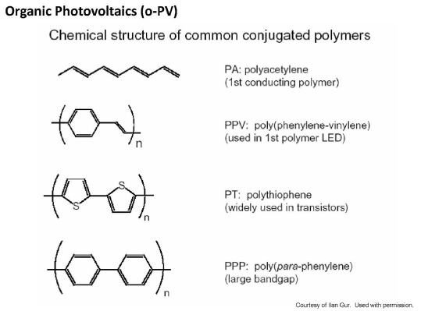

Slide 26
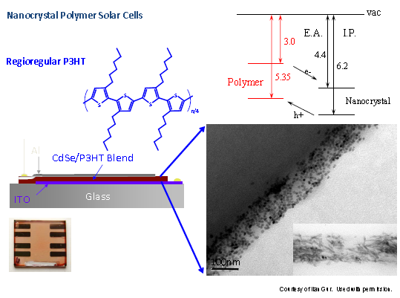
PEDOT:PSS

Slide 27
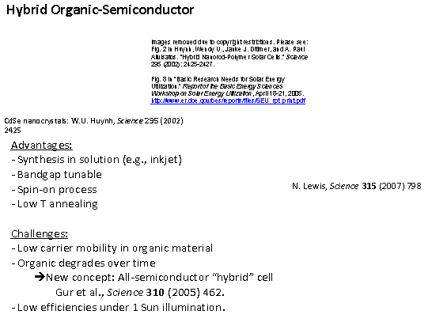
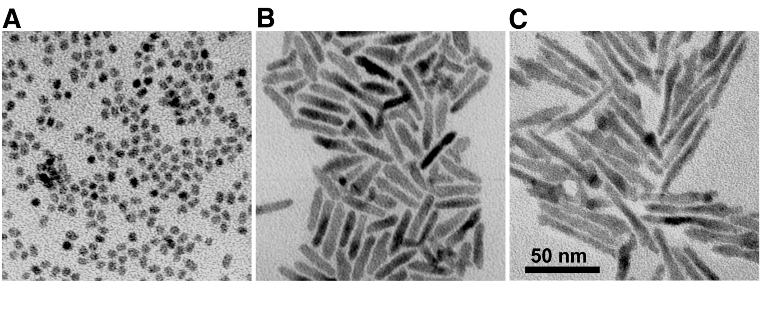
Cadmium selenide nanocrystals withaspect ratios ranging from 1 to 10. The samples, shown by transmission electron micro-
graphs ( TEMs) at the same scale, have dimensions (A) 7 nm by 7 nm, (B) 7 nm by 30 nm, and(C) 7 nm by 60 nm.

Slide 28
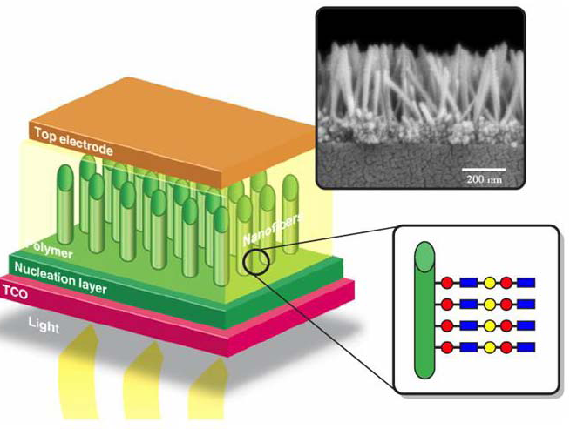
Structure for high-efficiency (50%) organic PV cell based
on a nanostructured substrate onto which thin layers of molecular
multi-junctions are grown and anchored onto the nanostructure
surface. The red circle denotes an electron acceptor; the blue square,
an electron donor; and the yellow circle, a metal nanoparticle

Slide 29
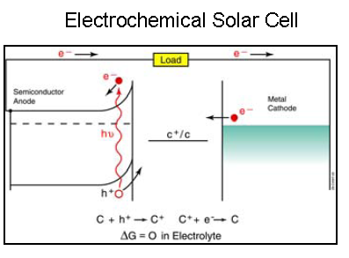
PHOTOELECTROCHEMICAL (PEC) SOLAR CELLS
First Configuration
Hybrid structures of inorganic semiconductors and molecular structures.
Electrolyte contains redox couplings.
Redox couple accepts holes at one electrode and accepts electrons at the other electrode — resulting in
charge neutralization and no net change in the redox species.
Electrolyte &redox couple completes electrical
circuit and produce electric field required for charge separation.
Electrolyte
n /p type
Electric field @ surface
Electrochemical PV Cell (EPV)

Slide 30
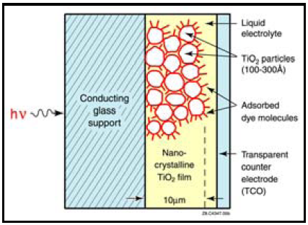
Second Configuration

Slide 31
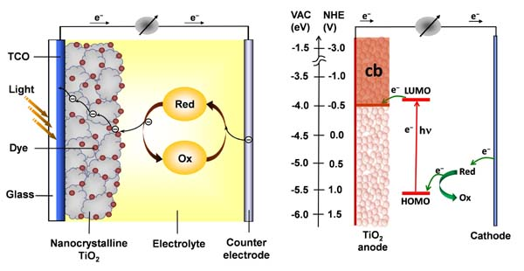
Dye Sensitized Solar Cells
TiO2 does not absorb much sunlight bcos band gap is too big (3.0 eV),only UV
TiO2 is porous with high surface area
Ruthenium-polypyridine dye
Iodide electrolyte
So dye molecule is excited.
é́ is transferred into TiO2(anode) by diffusion
Dye molecule becomes +charged (hole)
This is he charge separation phase of the PV
Semiconductor is used solely for charge transport
Iodide electrolyte is used
e is retuned back into the electrolyte
Dye molecule is regenerated again

Slide 32
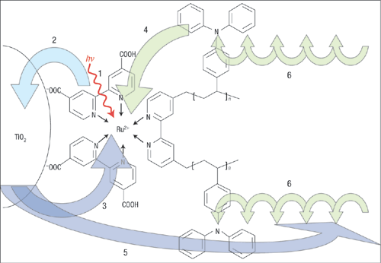
Notes:
This is the structure of the redox triad that gave the most efficient charge seperation in the report by Haque and colleagues³. The triad is made of a ruthenium complex (the chromophore) anchored to nanocrystalline TiO₂ (the electron acceptor) and covalently linked to polymeric chains of triphenyl-amine groups (the electron donor). Arrows represent the direction of the electron transfer process. The first step of the electron transfer is the light-induced excitation of the chromophore (process 1). Following this an electron is readily injected from the chromophore excited state into the conduction band of the TiO₂ semiconductor (process 2). The direct recombination of primarily separated charges (process 3) would degrade the absorbed energy into heat. In this supermolecule this is avoided through the fast reduction of the ruthenium by the linked triphenyl-amine electron donor groups (process 4). The secondary recombination process (process 5) between the injected electron and the oxidized amine radical is made increasingly slow because the positive charge can hop from one triphenylamine function to the adjacent one along the chain (process 6) and the hole moves away from the TiO₂surface. The overall photo-initiated process thus results in unidirectional electron flow from the end of the polymeric chains to the oxide (from right to left) and a very long-lived charge-separated state.

Slide 33
